Slide 1
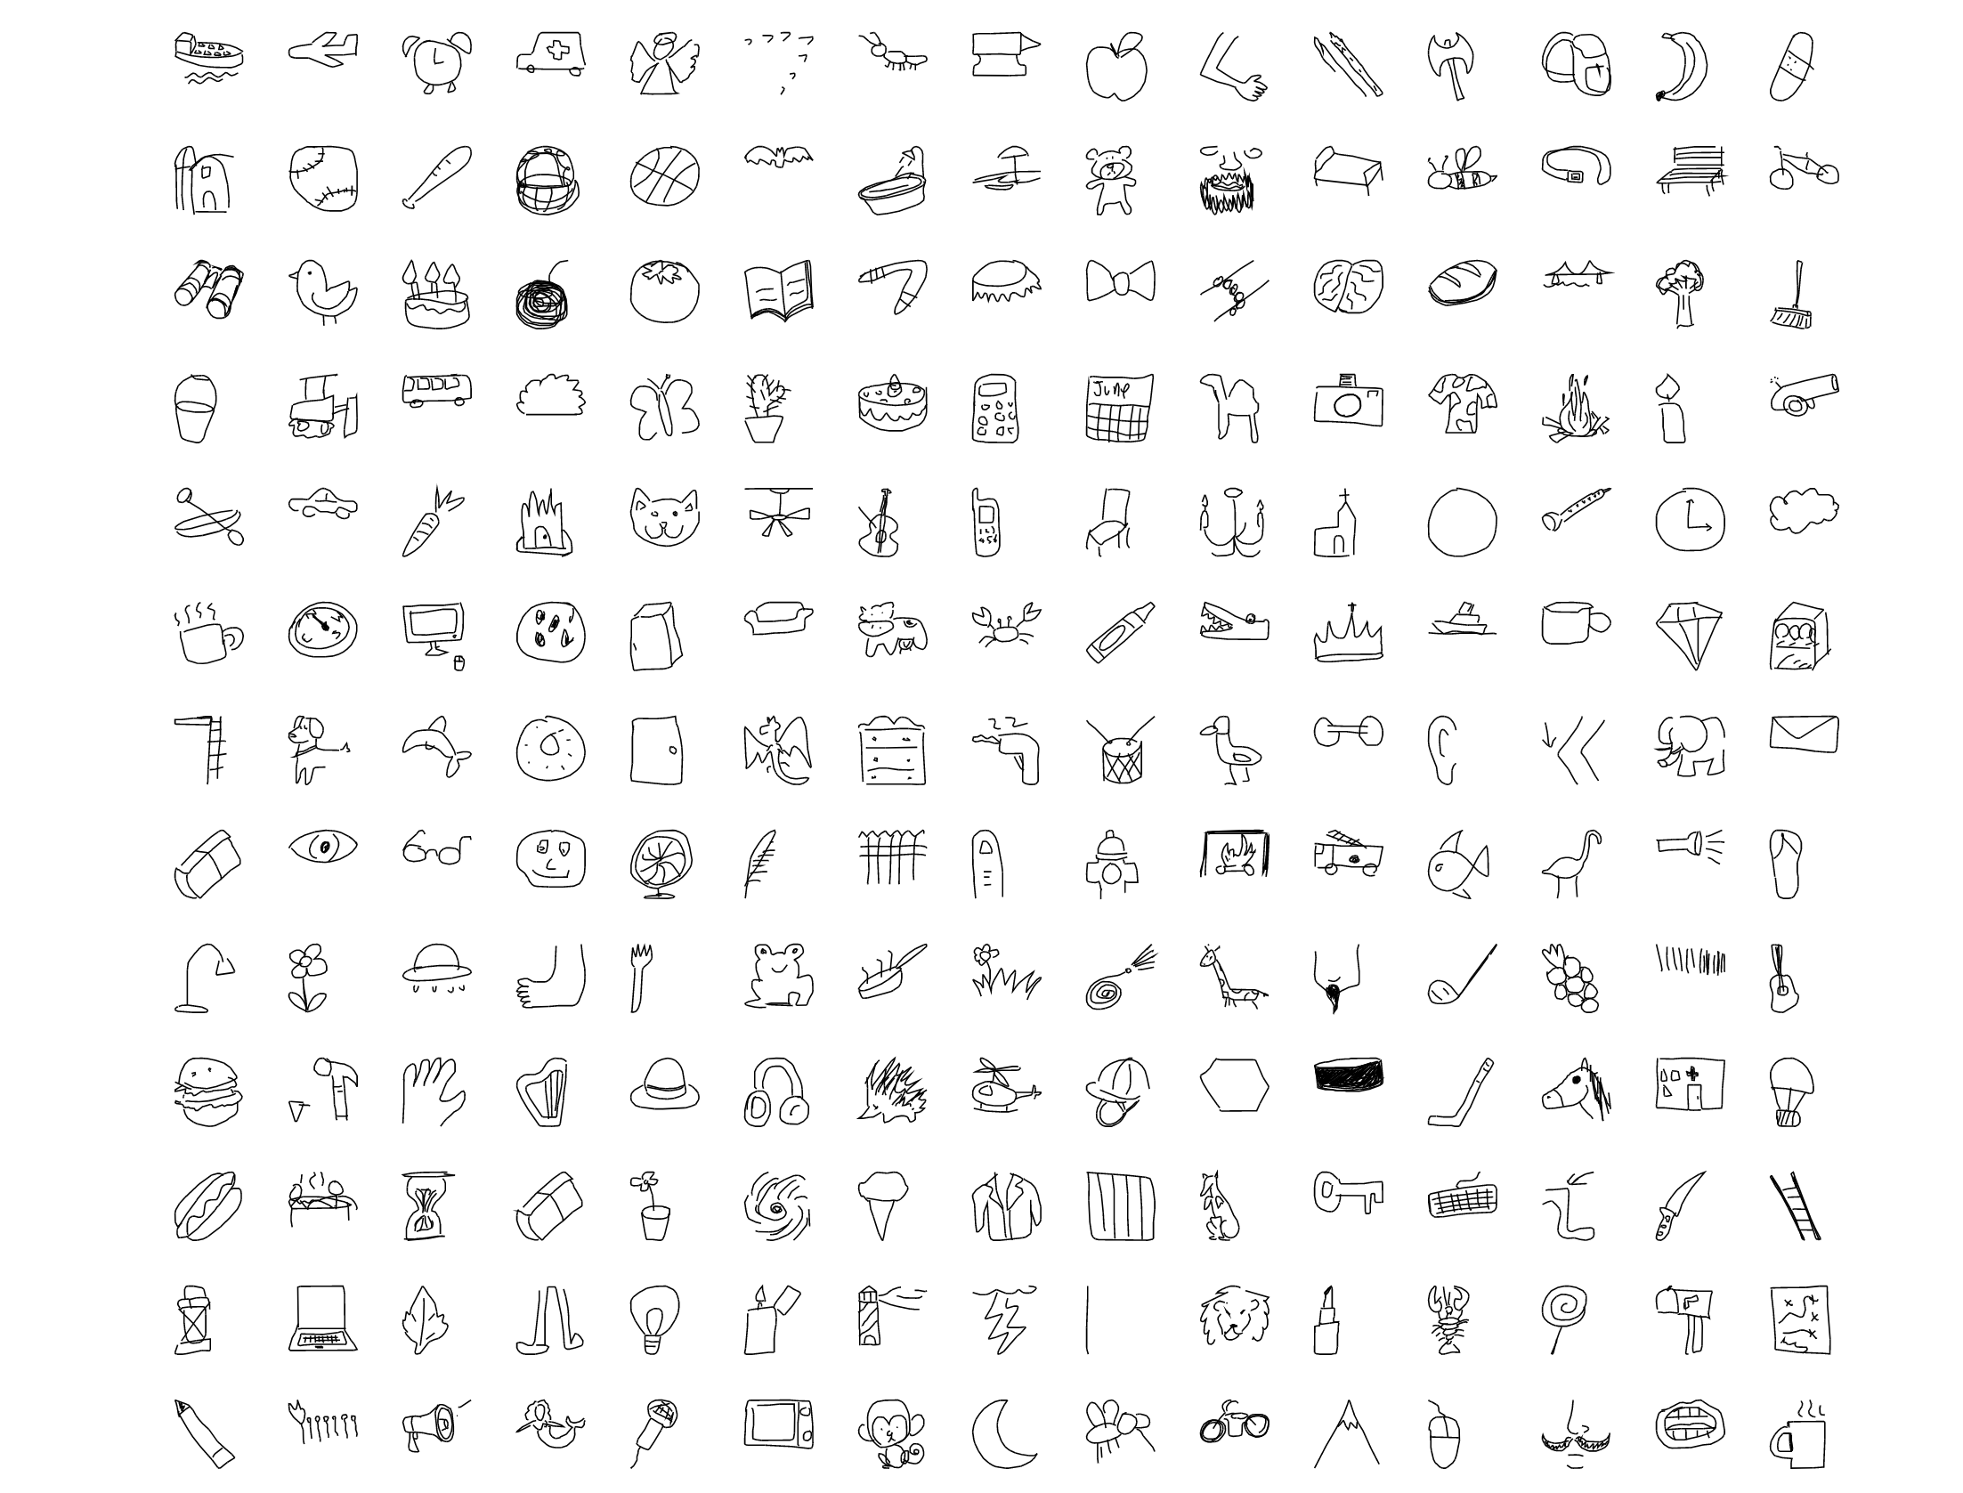
What are you drawing?
Google Quick, Draw! doodle recognition
Group 7: Tong Li, Kenny Jin, Runxin Gao

Slide 2
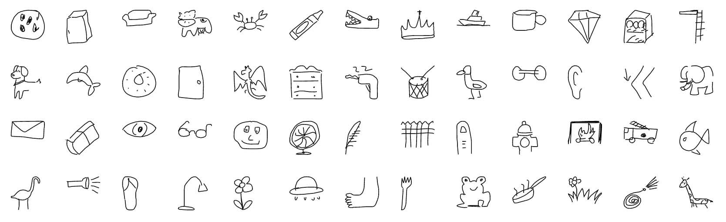
Quick, Draw! Examples
https://github.com/googlecreativelab/quickdraw-dataset/blob/master/preview.jpg

Slide 3
Motivation and Goals
Educational purpose for language learning toddlers
Build machine learning models to classify these drawings
Compare different machine learning algorithms and their performance
Explore the characteristics of these drawings

Slide 4
Data
The dataset provided by Google has 345 categories, with thousands of drawings in each. We used integers ( 0 - 344) to represent each category
The data used is in Numpy Bitmap Format (.npy), each image has dimensions of 28 * 28 = 784
We randomly sampled 1000 drawings from each category
345,000 images in total

Slide 5
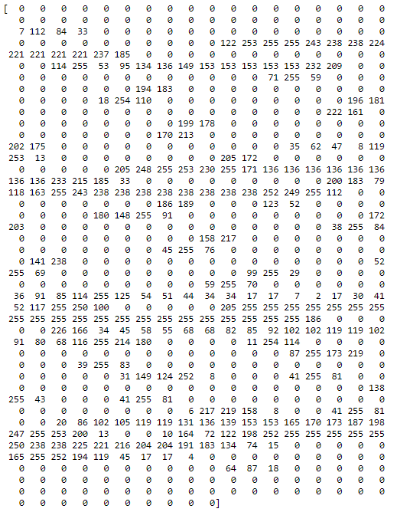
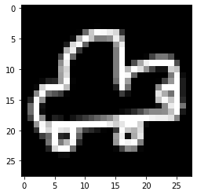
A snippet of our data
A doodle of ‘car’
We represent each image as a 28*28 = 784 dimensional vector

Slide 6
Getting Things Ready
We standardized the image vector by dividing 255
Original : 0 - 255
Standardized: 0 - 1
Stratified train_test_split
Training set: 80% of sample (800 images for each category)
Test set: 20% of sample (200 images for each category)

Slide 7
Models Adopted
k-Nearest Neighbors (k-NN)
Multinomial Logistic Regression
Random Forest
Convolutional Neural Network (CNN)
k-Means Clustering

Slide 8
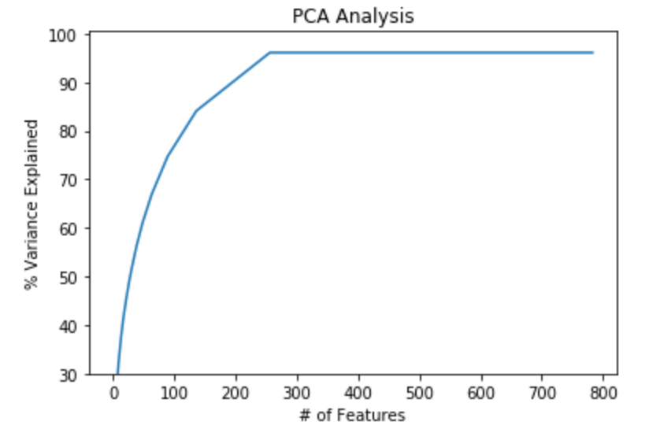
Dimensionality Reduction
PCA
Max is achieved at component = 256
But there does not seem to be a significant difference between 100, 200 and 256
We used 100 components

Slide 9
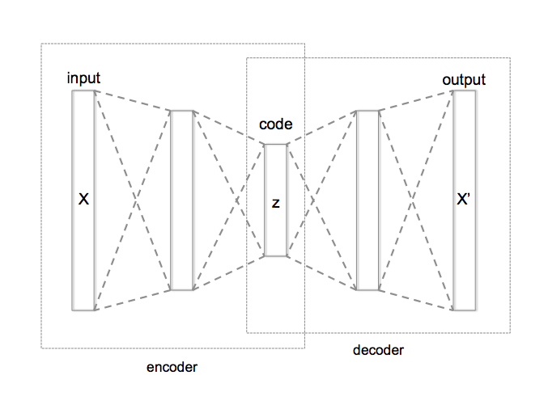
Dimensionality Reduction
Autoencoder
An autoencoder is a type of artificial neural network used to learn efficient data codings in an unsupervised manner.[1]
We compressed the data into 100 dimensions
https://upload.wikimedia.org/wikipedia/commons/2/28/Autoencoder_structure.png
[1]: Kramer, Mark A. (1991). "Nonlinear principal component analysis using autoassociative neural networks" (PDF). AIChE Journal. 37 (2): 233–243. doi:10.1002/aic.690370209.
Notes:
Kan chat

Slide 10
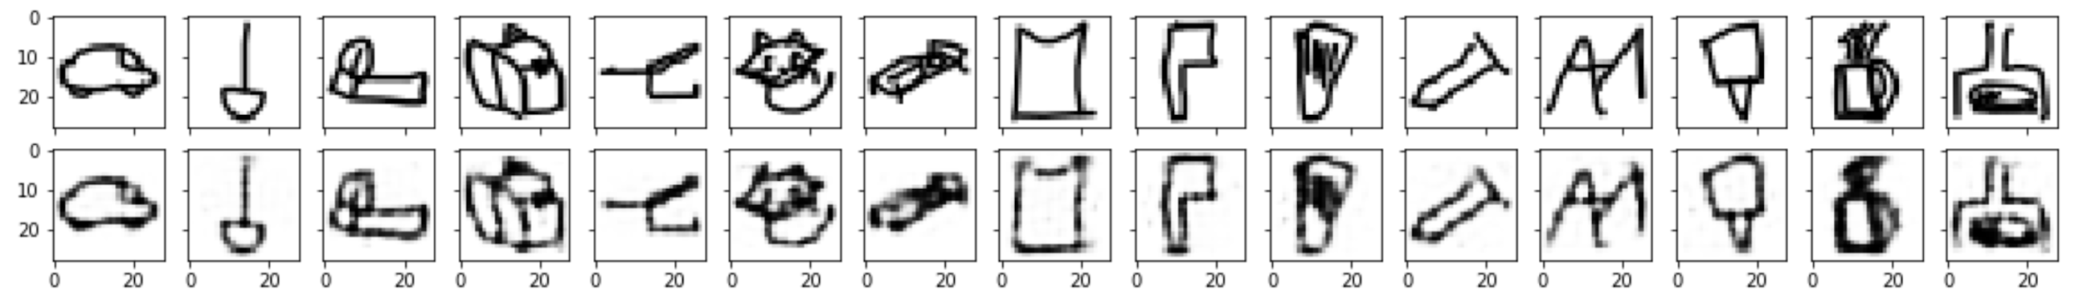
Dimensionality Reduction
Autoencoder
Original Image:
Image reconstructed from Autoencoder
Notes:
Kan chat

Slide 11
k-NN
Lazy algorithm, susceptible to curse of dimensionality
PCA and Autoencoder are used to reduce dimensions
5-fold Cross Validation for tuning hyperparameter
K = 15 is preferred
Accuracy is not bad

Slide 12
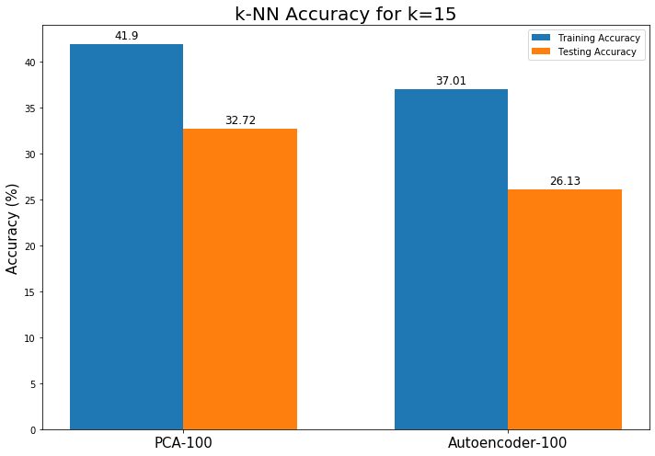
k-NN Accuracy

Slide 13
2. Multinomial Logistic Regression
Three sets of training data are fit into the regression
PCA-transformed
Autoencoder-transformed
Original training set, with 784 dimensions
5-fold Cross-Validation
Accuracy is relatively low

Slide 14
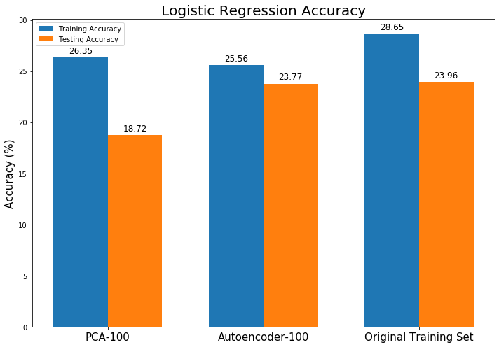
Accuracy

Slide 15
3. Random Forest
As in previous cases, we also created two sets of data for Random Forest
PCA-transformed, with 100 components
Autoencoder, compressed into dimension of 100
For each RF, we used 500 estimators, with max_leaf = 16

Slide 16
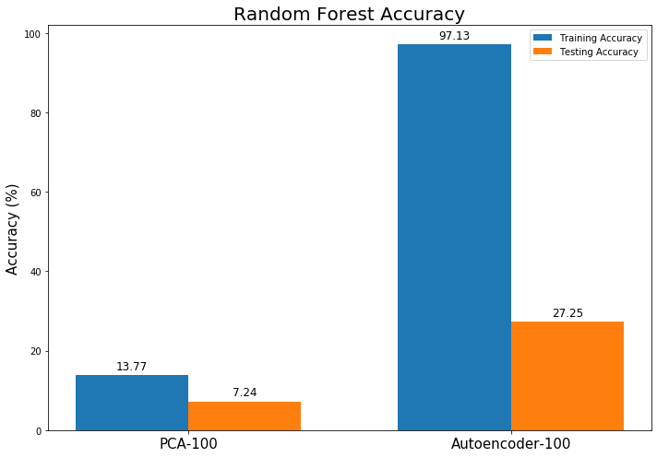
Accuracy

Slide 17
4. CNN
A powerful deep learning model, especially useful for image classifications.
Two CNN models (LeNet-5 and ResNet-34) are trained for doodle classifications. Both have better prediction accuracies than all other models we have tried.
ResNet-34 is slower to train but has better prediction accuracy than LeNet-5.
We referred to Prof. Raschka’s implementation of LeNet-5 and ResNet-34. https://github.com/rasbt/deeplearning-models/tree/master/pytorch_ipynb/cnn

Slide 18
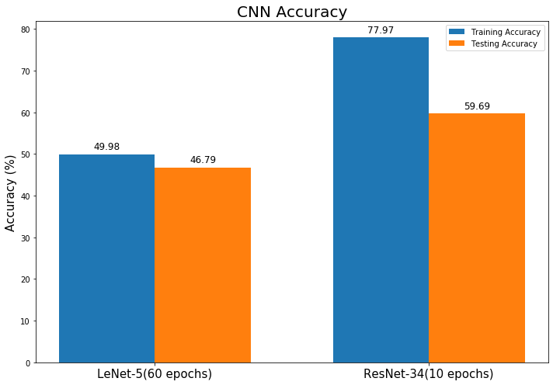
Accuracy

Slide 19
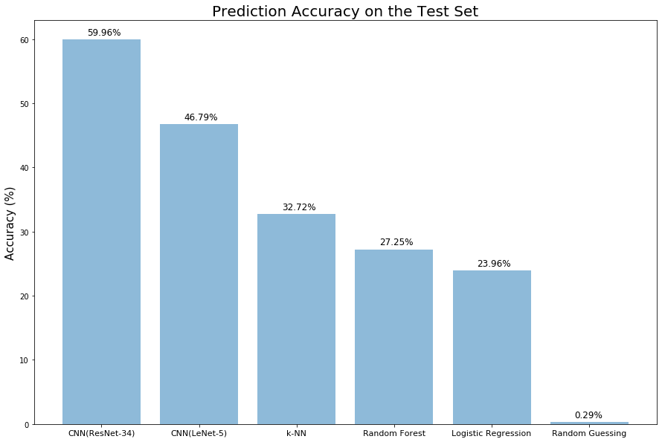
Prediction Accuracy Revisited
CNN (ResNet-34) gives the best test set prediction accuracy of 59.96%
Logistic Regression gives the worst test set prediction accuracy of 23.96%

Slide 20
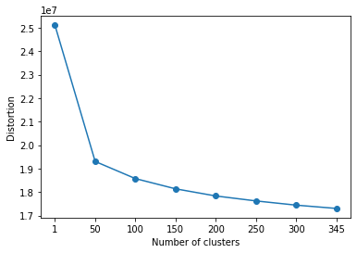
Mini batch K-Means clustering
--Exploring drawing styles
Number of clusters:
1, 50, 100, 150, 200, 250, 300, 345
Optimal K:
Elbow method --> K =150

Slide 21
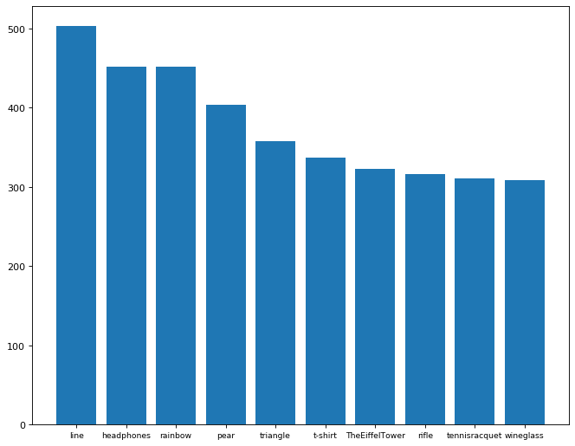
Explore clusters
Top 10 categories of the highest frequency in distinct clusters:
line
headphones
rainbow
pear
triangle
t-shirt
The Eiffel Tower
rifle
tennis racquet
wine glass
number

Slide 22
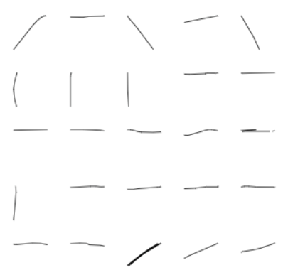
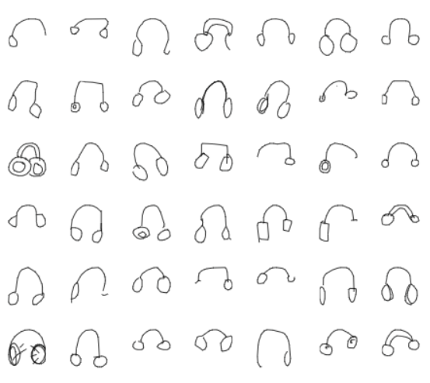
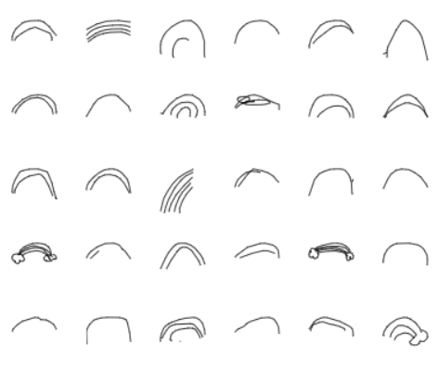
line
headphones
rainbow

Slide 23
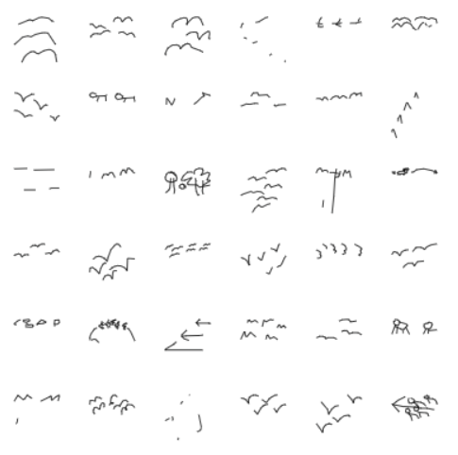
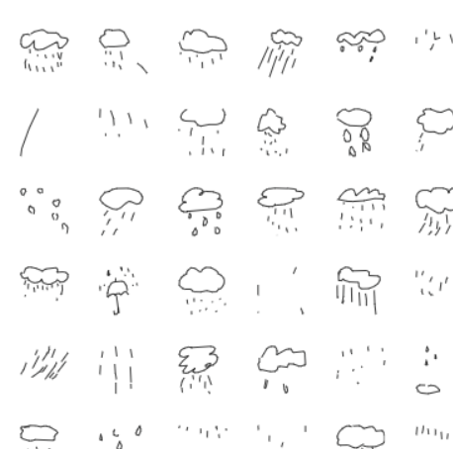
Explore clusters
People tend to use simpler ways to draw complex/abstract category:
Animal migration
Rain

Slide 24
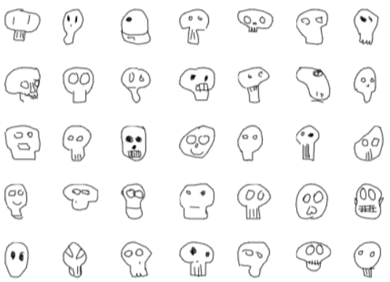
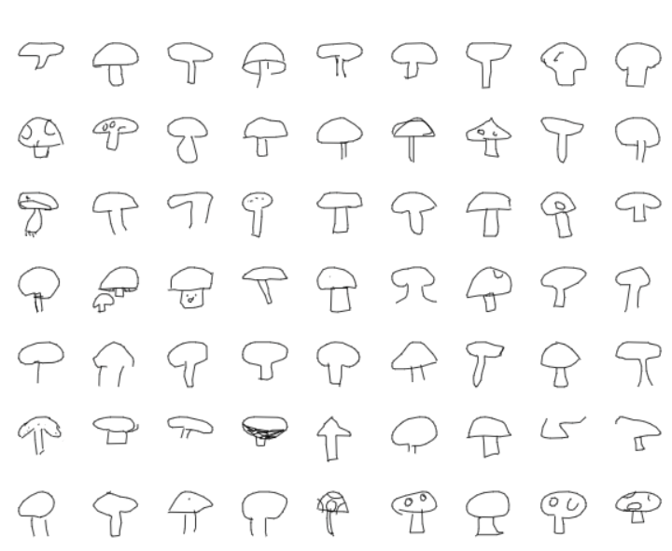
Interesting findings
Skull
Mushroom

Slide 25
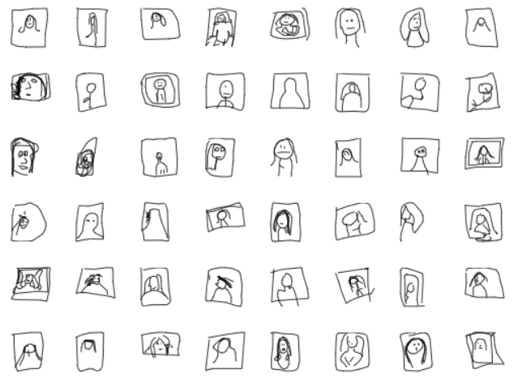

Interesting findings
The Mona Lisa
Calculator

Slide 26
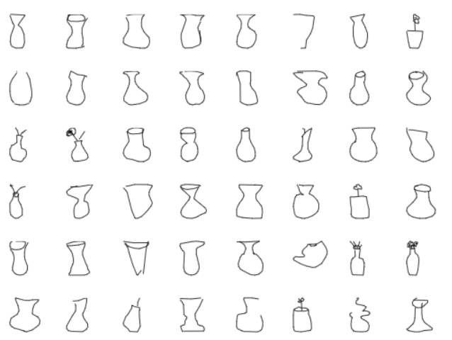
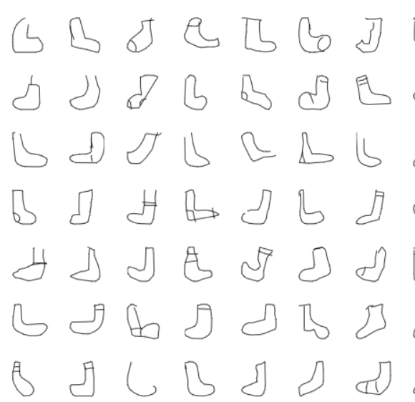
Interesting findings
vase
sock

Slide 27
Next Steps:
New metric for accuracy score
Current strict binary criterion seems too harsh, given the amount of categories we have (345 in total) and the similarity between some doodles from different categories
Give partial point for misclassified, but similar categories
Further hyperparameter tuning
Apply additional algorithms to compare results

Slide 28
Questions?

